Slide 1
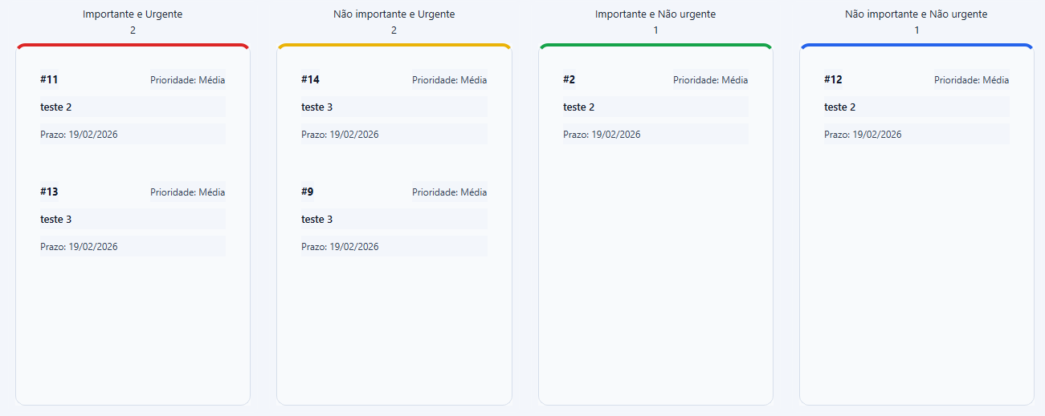

Slide 3
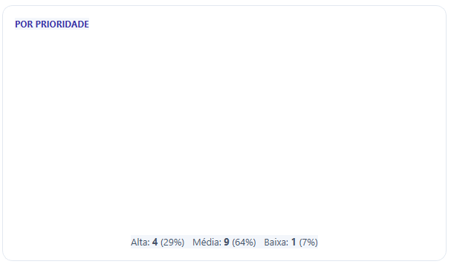

1 – 7%
4 – 29%
9 – 64%

